Slide 1

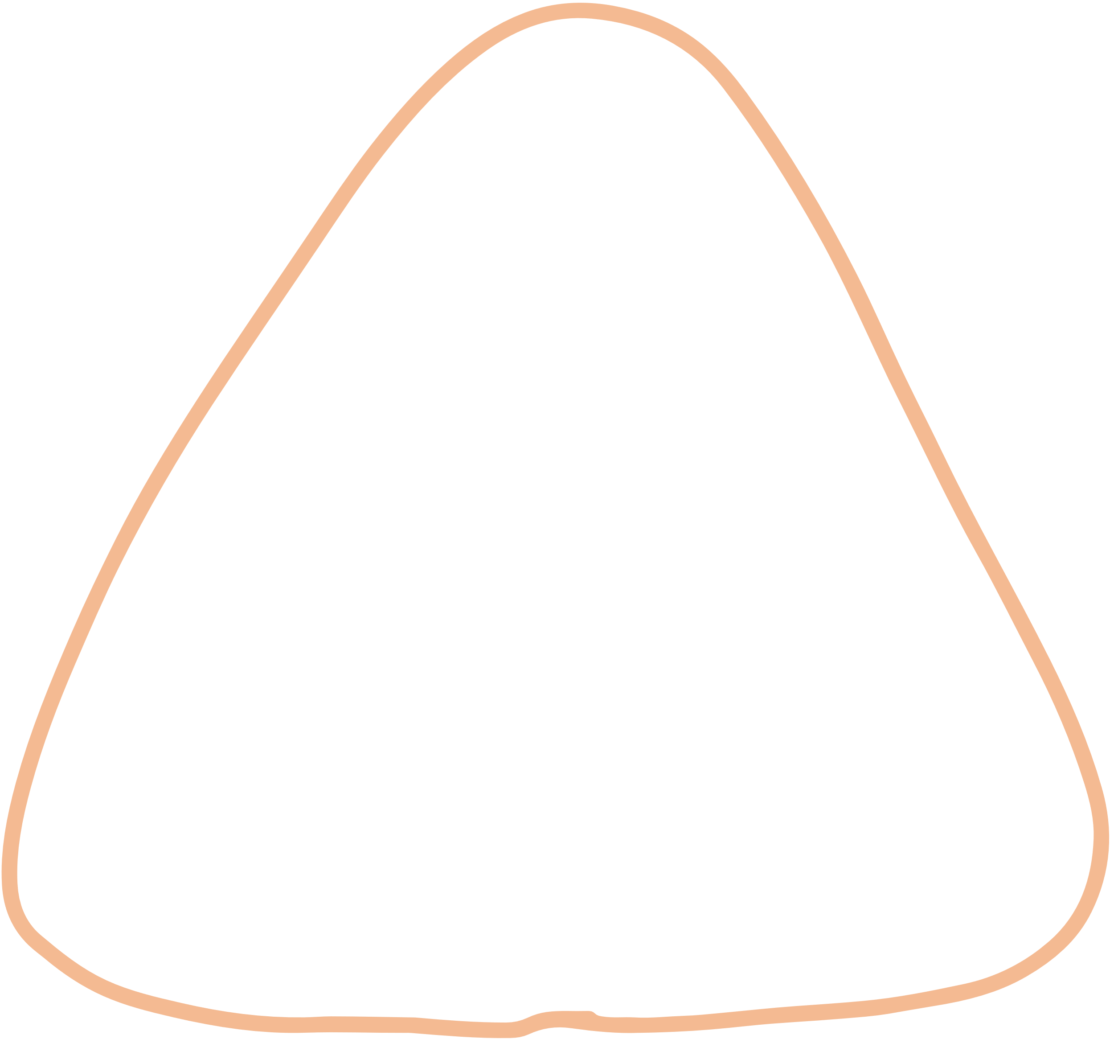






Bin Packing with lower bound,
upper bound
An interesting variation of a classic problem

Slide 2






PROBLEM INTRODUCTION

Slide 3


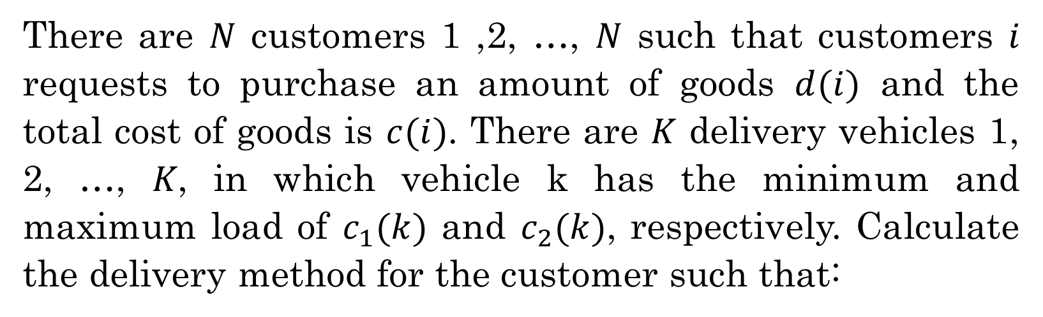
PROBLEM INTRODUCTION
There are 𝑁 customers 1 ,2, …, 𝑁 such that customers 𝑖 requests to purchase an amount of goods $d(i)$ and the total cost of goods is $c(i)$. There are 𝐾 delivery vehicles 1, 2, …, 𝐾, in which vehicle k has the minimum and maximum load of $c_{1}(k)$ and $c_{2}(k)$, respectively. Calculate the delivery method for the customer such that:
Each customer can only receive delivery by at most 1 vehicle.
The total amount of cargo on each vehicle must be within the minimum and maximum vehicle capacity.
The total cost of goods received by the served customers is maximized.

Slide 4





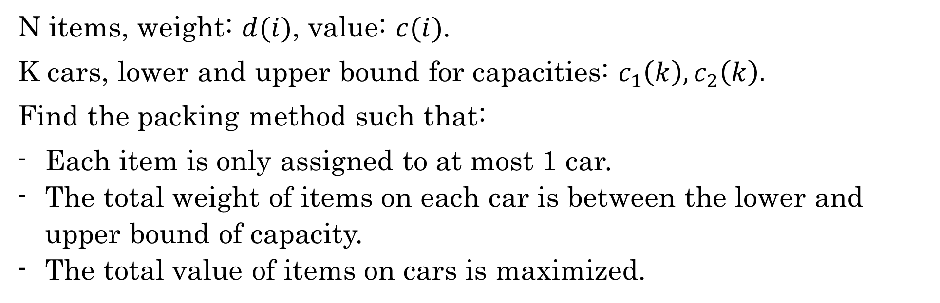
SIMPLE VERSION
N items, weight: $d(i)$, value: $c(i)$.
K cars, lower and upper bound for capacities: $c_{1}\left(k\right), c_{2}\left(k\right).$
Find the packing method such that:
Each item is only assigned to at most 1 car.
The total weight of items on each car is between the lower and upper bound of capacity.
The total value of items on cars is maximized.

Slide 5
INPUT SPECIFICATION

Slide 6



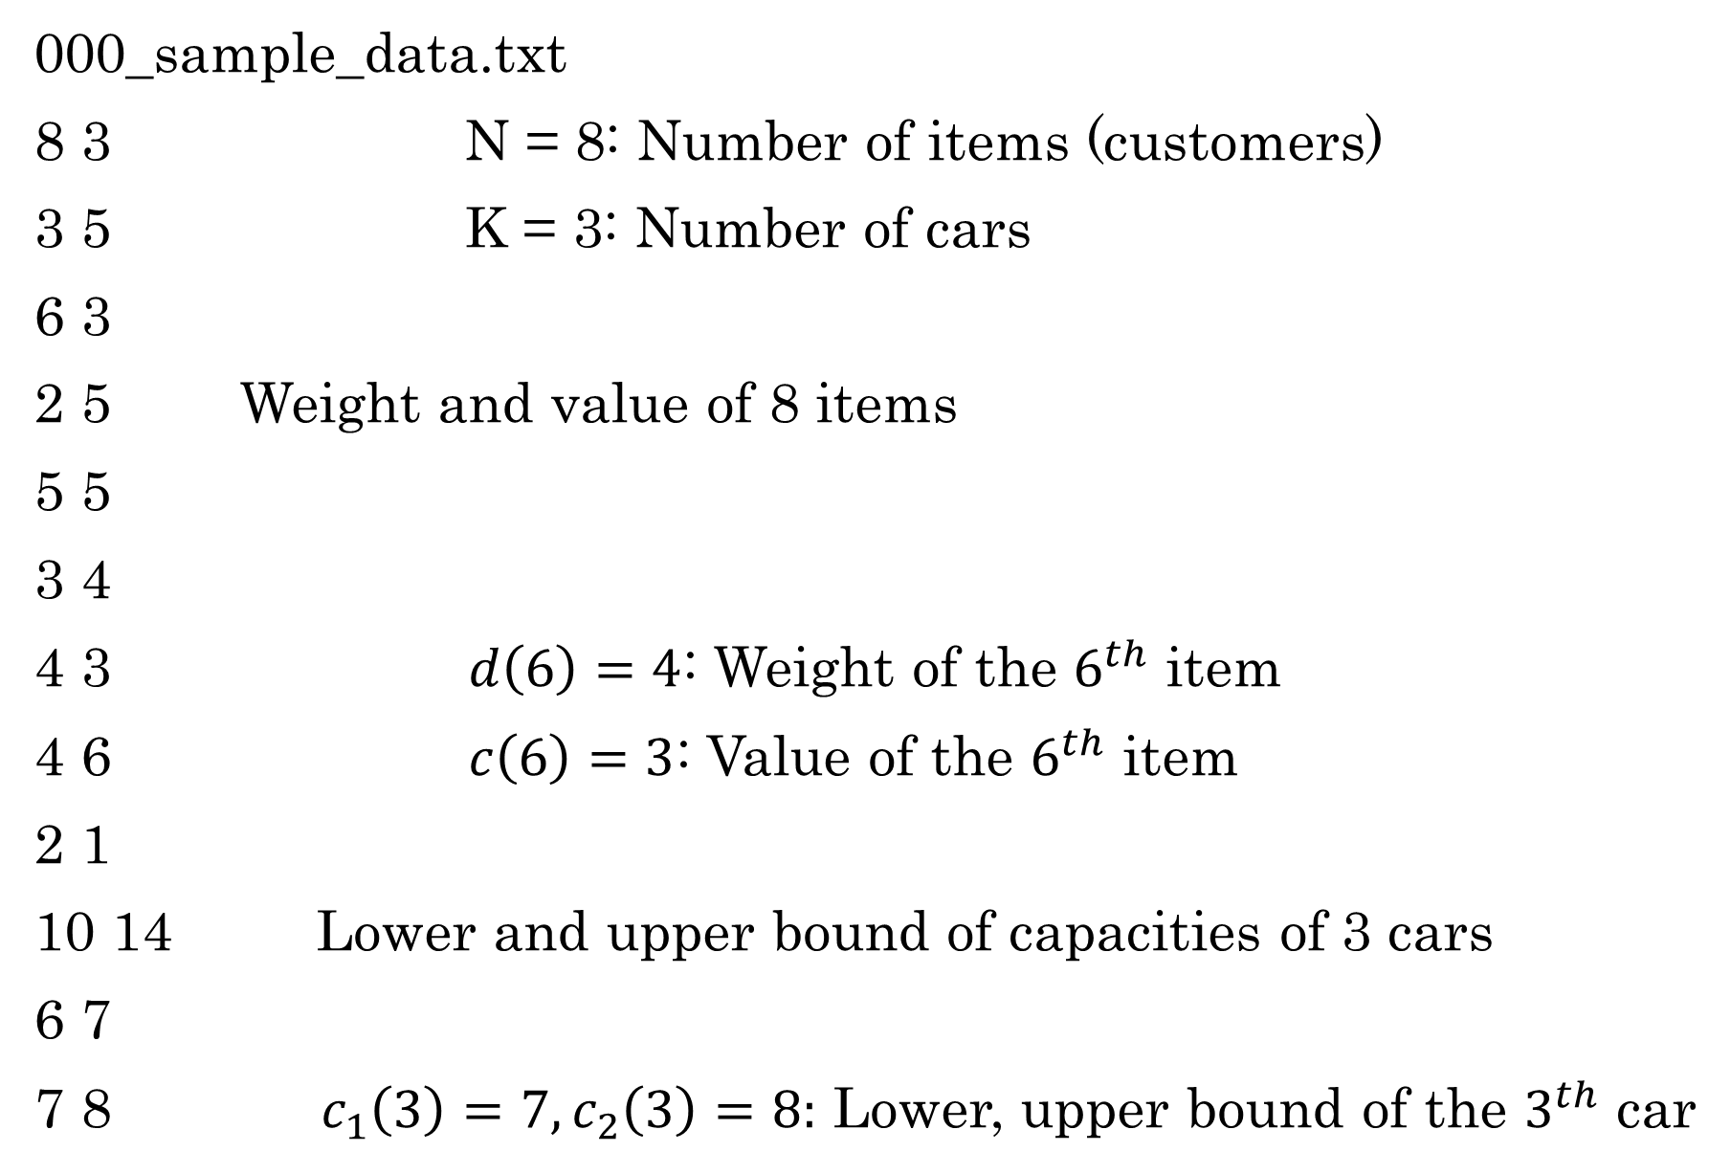
INPUT SPECIFICATION
000_sample_data.txt
8 3 N = 8: Number of items (customers)
3 5 K = 3: Number of cars
6 3
2 5 Weight and value of 8 items
5 5
3 4
4 3 $d\left(6\right)=4$: Weight of the $6^{th}$ item
4 6 $c\left(6\right)=3$: Value of the $6^{th}$ item
2 1
10 14 Lower and upper bound of capacities of 3 cars
6 7
7 8 $c_{1}\left(3\right)=7, c_{2}\left(3\right)=8:$ Lower, upper bound of the $3^{th}$ car

Slide 7
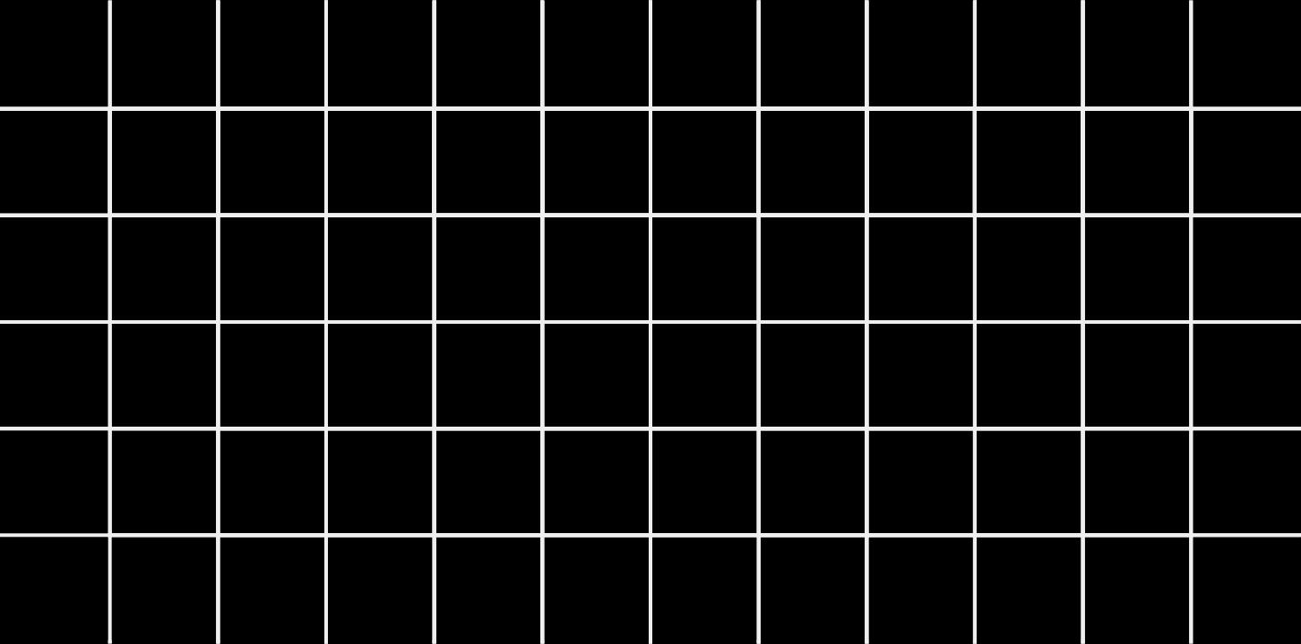






DATA GENERATION
And properties of data

Slide 8
Define the number of cars:
There will be 36 different input files, each of them has the number of cars (K) as follow:
20 easy and medium files: From 2 to 5 with 5 cases for each value of K
10 hard files: From 6 to 15 with step 1, i.e. 6, 7, 8, …, 15
6 very hard files: K = 20, 25, 30, 35, 40, 45
1 sample file

Slide 9
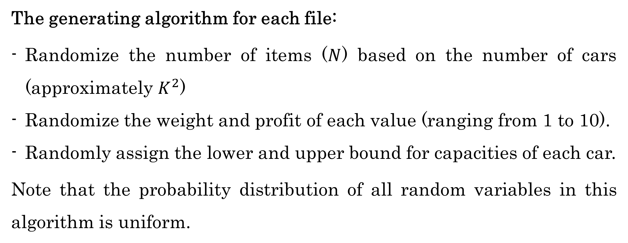
The generating algorithm for each file:
Randomize the number of items ($N$) based on the number of cars (approximately $K^{2}$)
Randomize the weight and profit of each value (ranging from 1 to 10).
Randomly assign the lower and upper bound for capacities of each car.
Note that the probability distribution of all random variables in this algorithm is uniform.

Slide 10
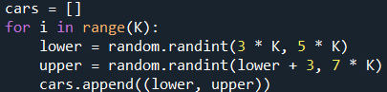
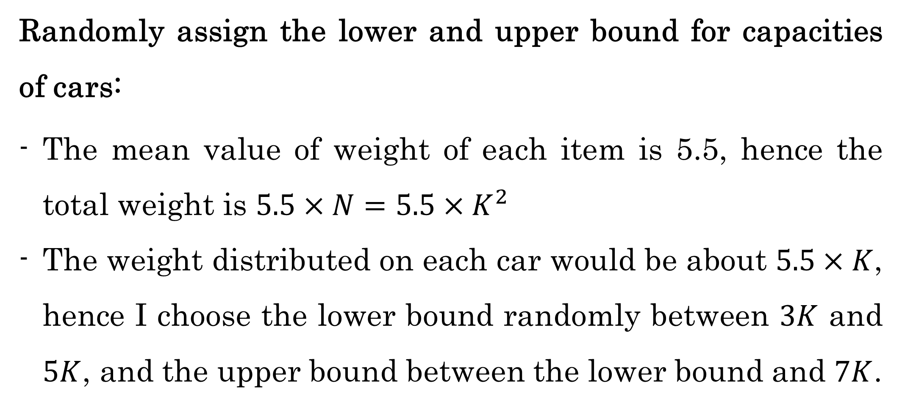
Randomly assign the lower and upper bound for capacities of cars:
The mean value of weight of each item is 5.5, hence the total weight is $5.5×N=5.5×K^{2}$
The weight distributed on each car would be about $5.5×K$, hence I choose the lower bound randomly between $3K$ and $5K$, and the upper bound between the lower bound and $7K$.

Slide 11
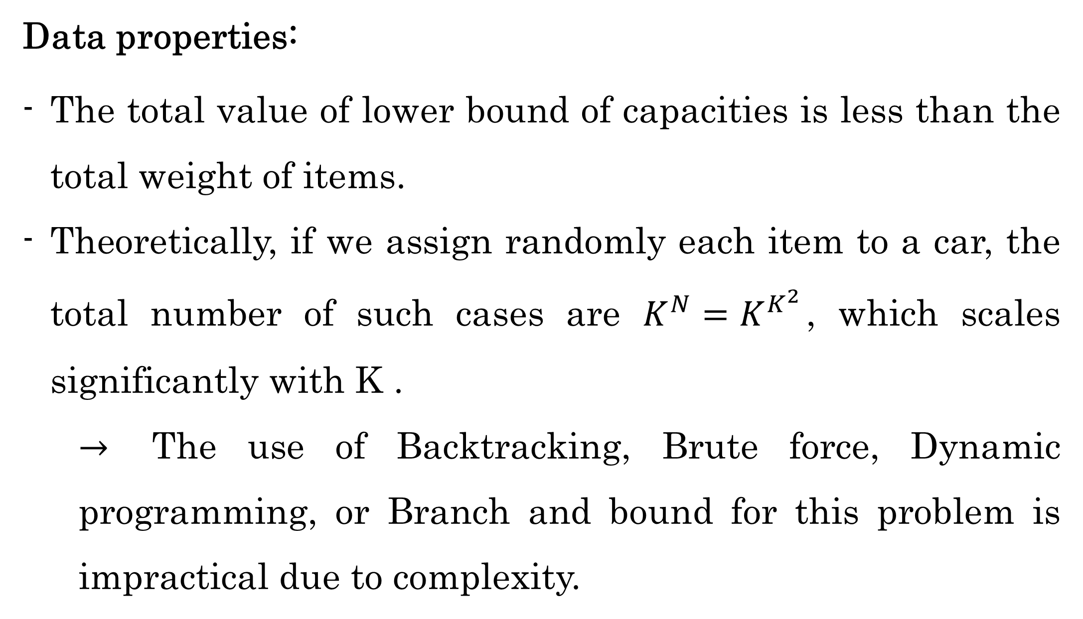
Data properties:
The total value of lower bound of capacities is less than the total weight of items.
Theoretically, if we assign randomly each item to a car, the total number of such cases are $K^{N}=K^{K^{2}}$, which scales significantly with K .
$→$ The use of Backtracking, Brute force, Dynamic programming, or Branch and bound for this problem is impractical due to complexity.

Slide 12
PROBLEM FORMULATION
Building CP and MIP models

Slide 13




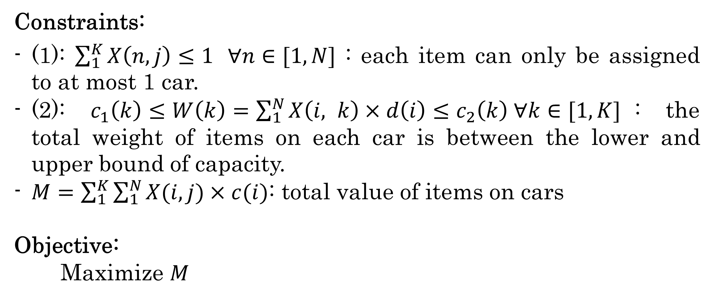
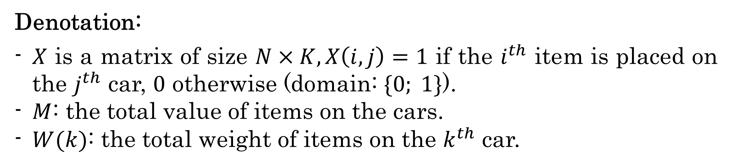
Denotation:
$X$ is a matrix of size $N×K, X\left(i,j\right)=1$ if the $i^{th}$ item is placed on the $j^{th}$ car, $0$ otherwise (domain: $\{0; 1\}$).
$M$: the total value of items on the cars.
$W(k)$: the total weight of items on the $k^{th}$ car.
Constraints:
(1): $\sum_{1}^{K}{X\left(n, j\right)≤1 } ∀n∈[1, N]$ : each item can only be assigned to at most 1 car.
(2): $c_{1}\left(k\right)≤W\left(k\right)=\sum_{1}^{N}{X\left(i, k\right)×d\left(i\right)}≤c_{2}\left(k\right) ∀k∈[1,K]$: the total weight of items on each car is between the lower and upper bound of capacity.
$M=\sum_{1}^{K}{\sum_{1}^{N}{X(i,j)×c(i)}}$: total value of items on cars
Objective:
Maximize $M$

Slide 14
ALGORITHMS

Slide 15
Backtracking (with upper bound pruning)
Local search
Iterated local search
MIP solver
CP solver

Slide 16
Analysis of algorithms
Practically analyze their performance

Slide 17



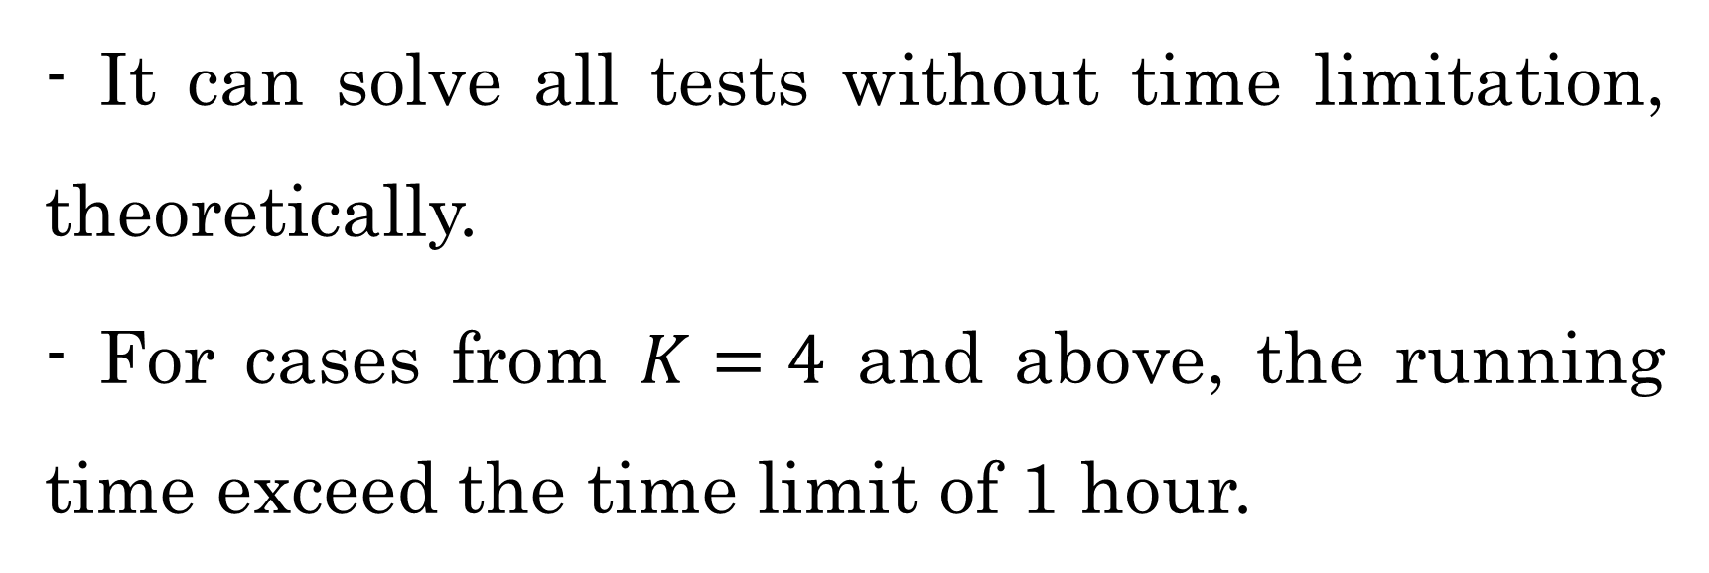
1. Backtracking
Example 1
- It can solve all tests without time limitation, theoretically.
- For cases from $K=4$ and above, the running time exceed the time limit of 1 hour.

Slide 18

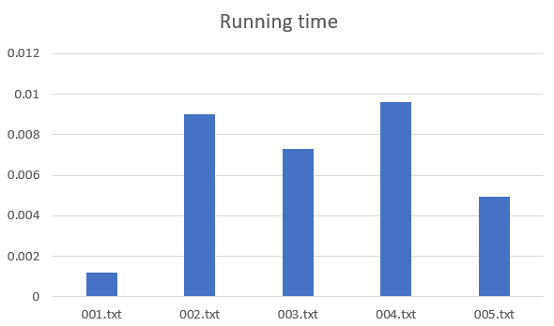
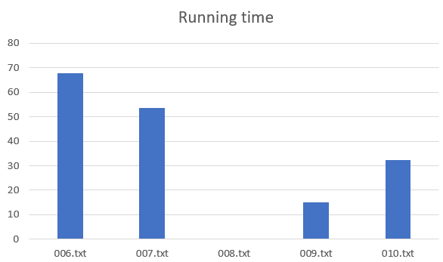

K = 2
K = 3

Slide 19



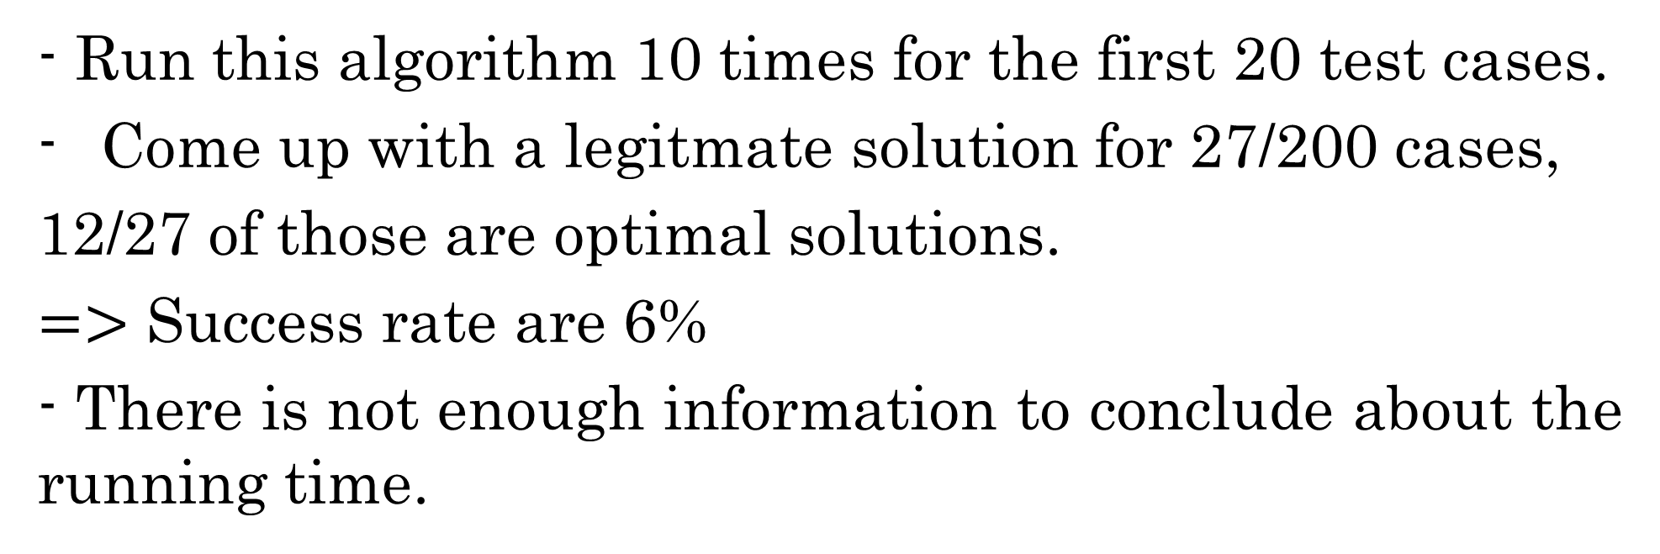
2. Local search
Example 2
- Run this algorithm 10 times for the first 20 test cases.
Come up with a legitmate solution for 27/200 cases,
12/27 of those are optimal solutions.
$=>$ Success rate are 6%
- There is not enough information to conclude about the running time.

Slide 20



3. Iterated local search
- Run with 1000 iterations for each case.
- Come up with a legitmate solution for 19/36 test cases, 14/19 of those are optimal solutions.
- Out of the 16 hard and very hard cases, it can only find a legitimate solution for 1 case (not an optimal solution).
- There is not enough information to conclude about the running time.

Slide 21

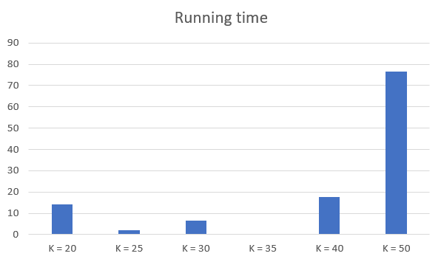

4. MIP model
- It can solve 35/36 test cases with a time limitation of 1 hour.
- The objective values of solved instances are excellent in general.
- The running time for each of the first 30 test cases is less than 1 second.
Running time for the 6 very hard files

Slide 22

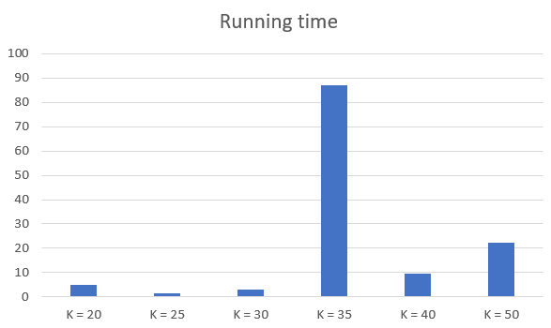

5. CP model
- It can solve 36/36 test cases with a time limitation of 1 hour.
- The objective values of solved instances are excellent in general.
- The running time for each of the first 30 test cases is less than 1 second.
Running time for the 6 very hard files

Slide 23



Conclusion
Backtracking: not impractical
Local search: very low efficiency
Iterated local search: moderate efficiency (for easy and medium cases), low efficiency (for hard cases)
MIP model: high efficiency
CP model: high efficiency (run faster than MIP model)

Slide 24

Improve the current algorithms:
Backtracking:
+ Improve the pruning technique.
+ Change the order of states.
Local search and iterated local search:
+ Change the way of choosing neighbor state.
+ Reduce the cost for the legitimate checking function to increase the number of possible iterations without exceeding the time limit.
Proposals
Incorporate other algorithms:
Beam search
Simulated annealing
Genetic algorithm
…
Investigate further into generating and working with large test sets.

Slide 25

THANK YOU
SEE YOU IN THE NEXT CLASS!

